Slide 1

FORTUNE 500 RANK AND PROFIT TREND ANALYSIS

Slide 2
About me
Background:
- M.Tech – CSE
Why you want to learn Data Science?
- To upskill my career in the field of data
Any work experience
- Working as a Data Analyst - Supply Chain & Business at QNL LLC.
- Achieved the Google Data Analytics Professional Certificate

Slide 3
Agenda
Business Problem and Use case domain understanding
- Analyzing and identifying the rank and profit trends of the global Fortune 500 companies
Objective of the Project
- Collect the latest 2022 data of the Fortune 500 companies, clean, analyze and give data-driven insights from the analysis
Web Scraping – Details (Websites, Processor you followed)
- Data collection from Fortune 500 website: https://fortune.com/fortune500/2022/search/
- Used Beautiful Soup and Selenium Web driver to web scrape the data
Summary of the Data
- Data showed that Fortune 500 companies are ranked based on the Revenues generated.

Slide 4
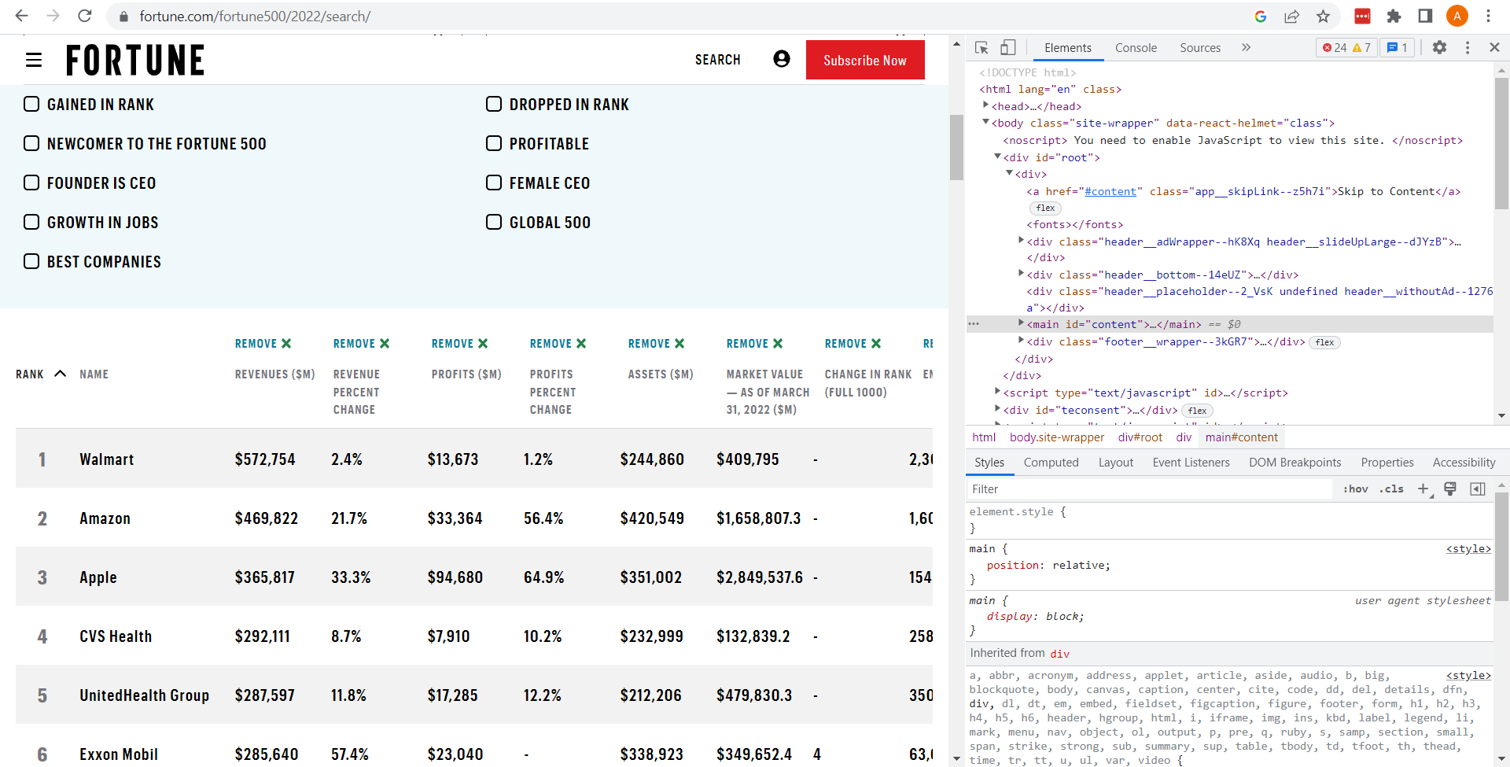

Slide 5
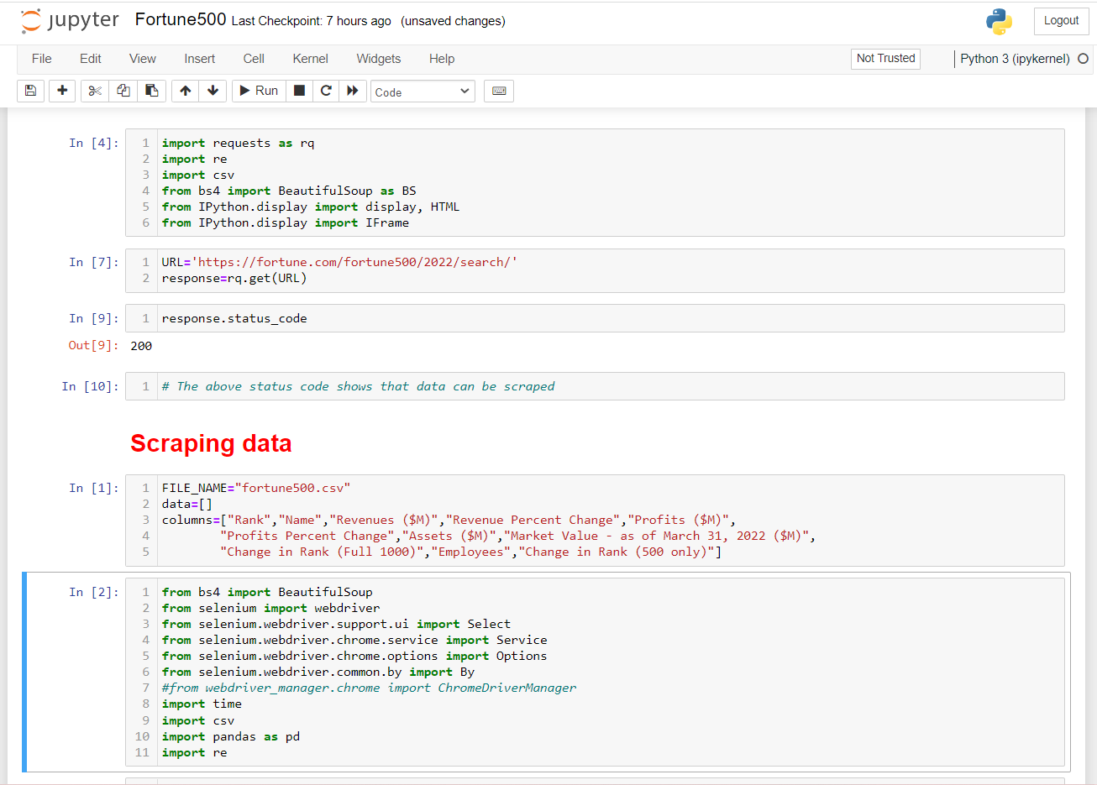

Slide 6
Exploratory Data Analysis:
Data Cleaning Steps
1. Dropped the unnecessary columns
2. Cleaned data by removing the special characters and converting the values to a consistent numeric data type format
3. Changed the data types of variables
Data Manipulation Steps
1. Converted empty values to null values
2. Replaced null values with the appropriate value
3. Checked statistical summary and outliers in each variable and treated them
4. Added new columns for further analysis

Slide 7
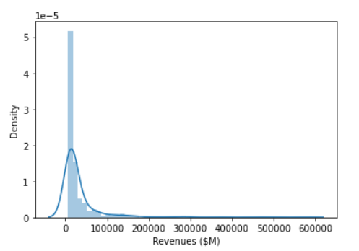
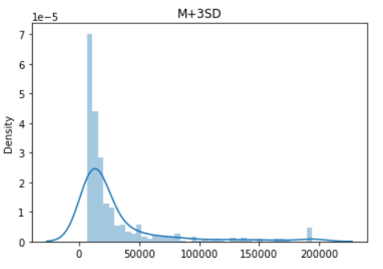
Univariate Analysis Steps
- Analyzed and Identified the distribution of variables
- Plotted Distribution plot, bar plot , violin plot to visualize the distribution
- Tried to reduce the skewness of data by treating the outliers. An example below:

Slide 8
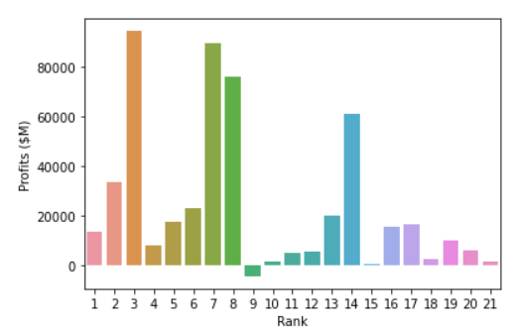
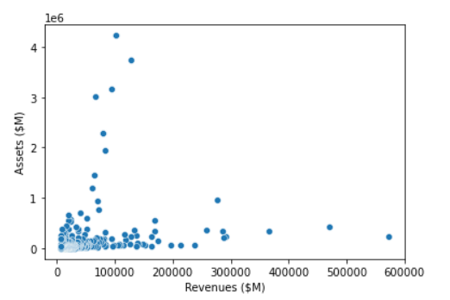
Bivariate Analysis Steps
- Analysed the behaviour of different numeric variables to see if they are co-related.
- Plotted scatterplots and bar plot to see the behaviour of variables.
- A few example below:

Slide 9
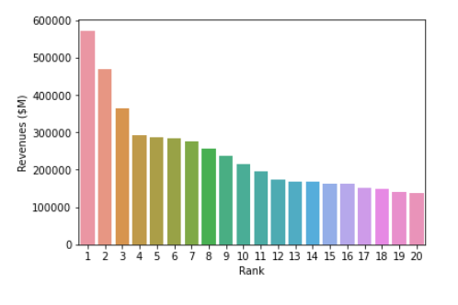
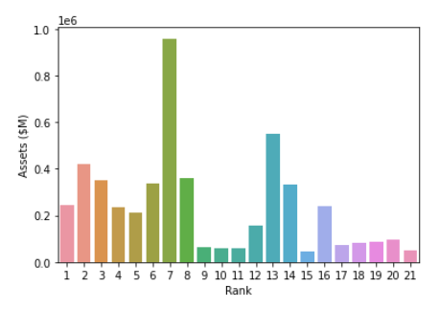

Slide 10
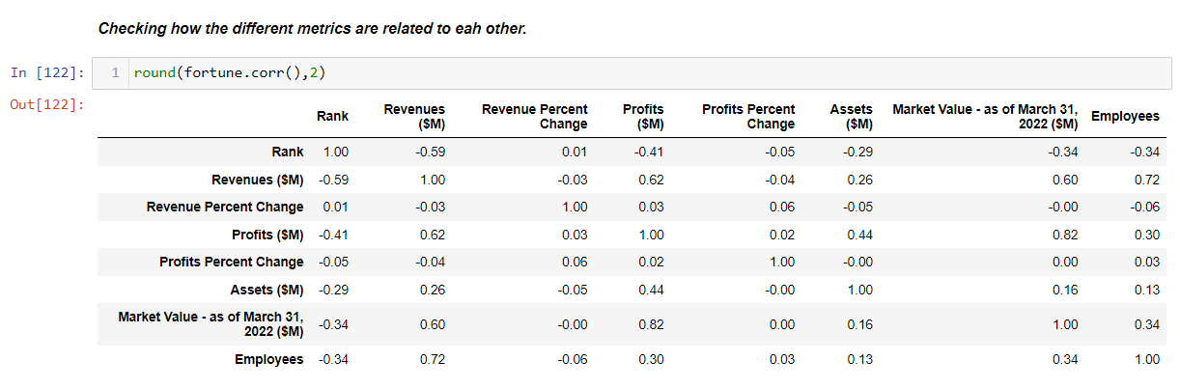
Multivariate Analysis Steps
- Analysed the behaviour of multiple numeric variables to see their co-related.
- The below illustrates the correlation metrics:

Slide 11
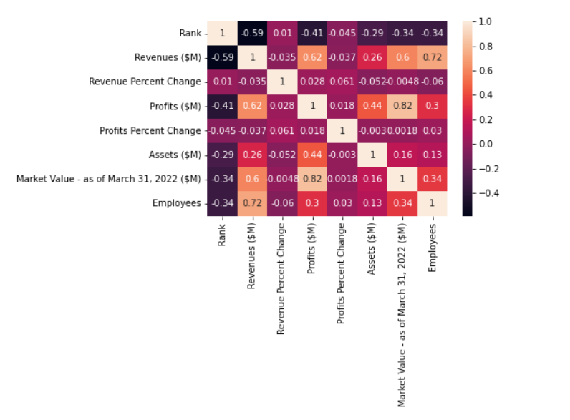
Plotted heatmap to see correlation of variables
Taking a correlation threshold of 0.5, the following conclusions can be made:
1. Rank and Revenues are negatively correlated
2. Rank and Profits are negatively correlated
3. Rank and Assets are negatively correlated
4. Assets and Revenues are less positively correlated
5. Revenues and Employees are highly positively correlated

Slide 12
Key Business Question
What are the key insights from the rank and profit trends? How can a company’s ranking be improved?
Conclusion (Key finding overall)
- The profit generated does not directly affect the ranking of the companies
- A general trend shows that with higher revenues, the profits are more.
- However, the annual revenue generated by the company directly impacts its ranking in the Fortune 500 list
- The companies should try to increase their sales which will generate higher revenues and in turn improve the ranking.

Slide 13
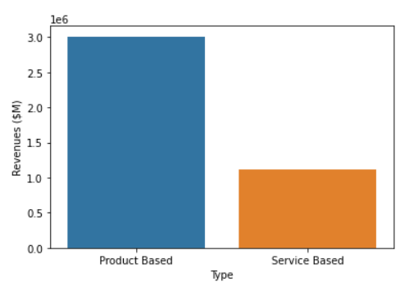
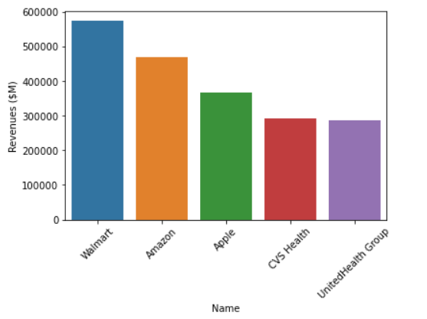
Product based companies generate higher revenues
Top 5 companies based on Rank and Revenue

Slide 14
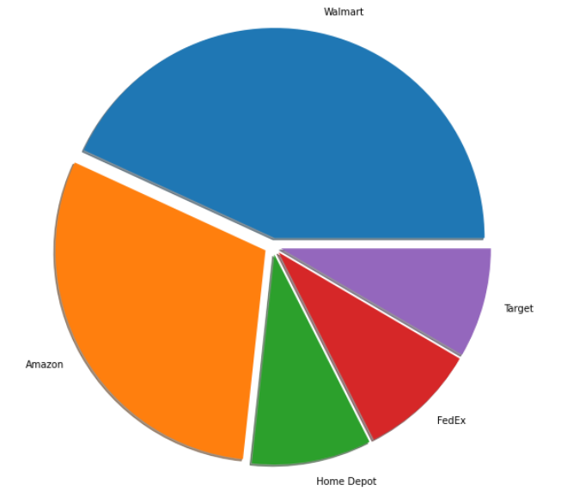
The top 5 companies providing the highest number of employment

Slide 15
Experience/Challenges working on Web Scraping – Data Analysis Project.
- Web scraping data from the Fortune 500 website was a challenge as the data was dynamic
- Learning and working with Selenium for the first time to scrape data
ANY QUESTIONS ?

Slide 16

THANK YOU

